Slide 1
“Agile is about social change”
-Kent Beck in “Extreme Programming”, 2004

Slide 2
Soziale Effekte
Agilen Projektmanagements
Val Richter

Slide 3
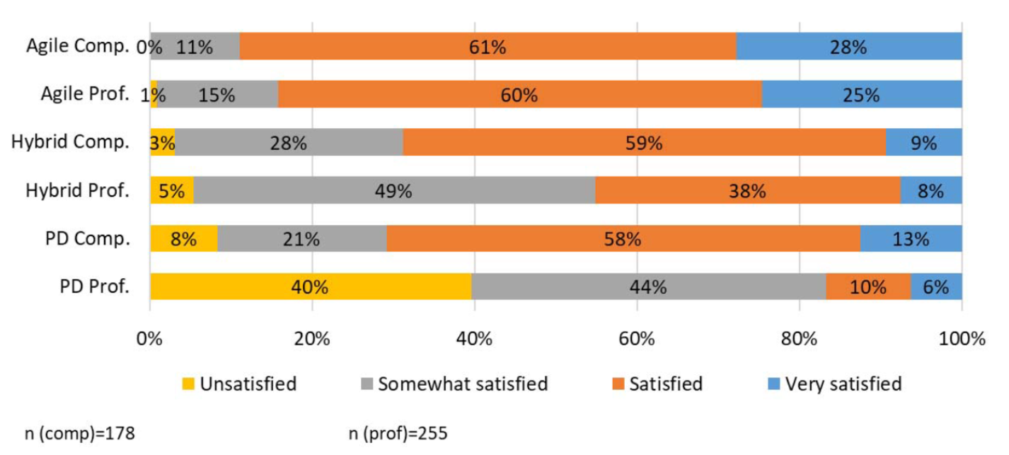
Zufriedenheit mit Agilem Projektmanagement
[1]
(comp=companies, prof=professionals, PD=Plan-Driven)

Slide 4
Positive Effekte
[2]
Zufriedenheit
Kommunikation
Verantwortung
Support
Teamzugehörigkeit
Verbindung zu Teammitgliedern
Engagement
“Agile Kultur”

Slide 5
Negative Effekte
[2], [3]
Soziale Bestrafungen
Sozialer Stress
Verantwortung
Neueinsteiger:innen
Team-Isolation
Rollen-Benachteiligung
Burnout
Gruppen Kontrolle

Slide 6
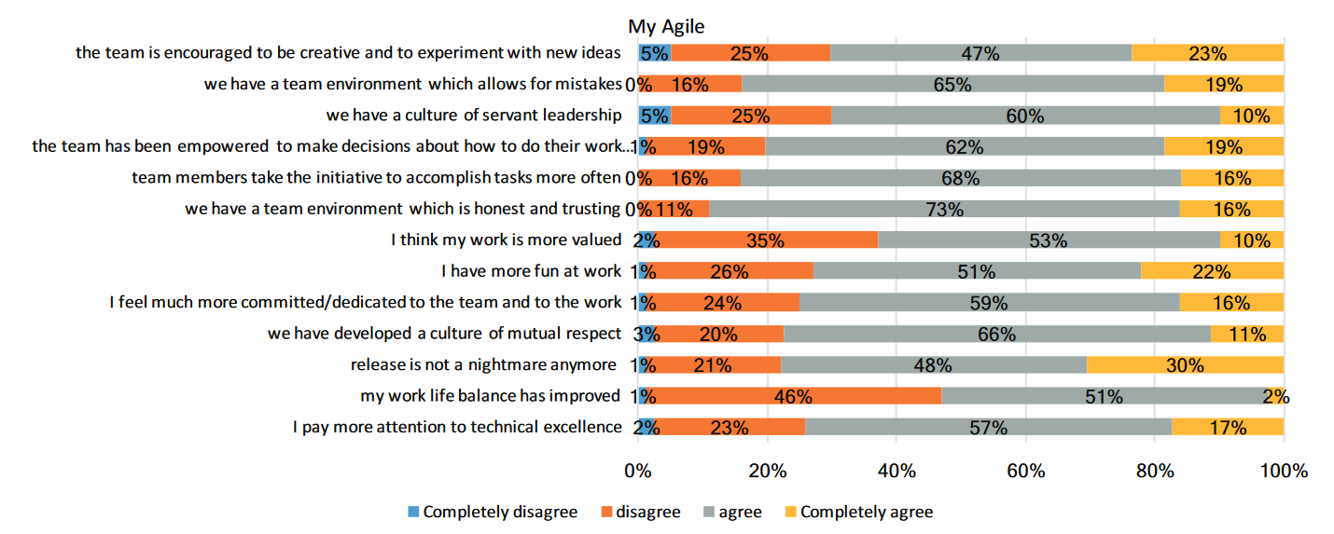
Effekte
[1]

Slide 7
Quellen
Biddle, Meier, Kropp, Anslow, 2018; “Myagile: Sociological and Cultural Effects of Agile on Teams and Their Members”, doi: 10.1145/3195836.3195845
Whitworth, Biddle, 2007; "The Social Nature of Agile Teams", doi: 10.1109/AGILE.2007.60
Cagle, 2019; “The End of Agile”, https://www.forbes.com/sites/cognitiveworld/2019/08/23/the-end-of-agile/

Slide 8
Limitationen
“Agile is about social change”
-Kent Beck in “Extreme Programming”, 2004

Slide 9
